Slide 1

B.Tech I-Year II-Sem
Subject: UI FRAMEWORKS
(MR23-1CS0106)

Slide 2

UNIT - I
ReactJs
React Installation,
React JSX,
React Components,
React State,
React Props,
Component Life Cycle,
React Forms.

Slide 3
What is UI FRAMEWORK?
The UI framework is a collection of pre-built components, libraries, and design elements.
The user interface framework accelerates the development of an application on the front end.
Components are reusable in creating user interfaces in software development.
Example of popular UI frameworks include React, Bootstrap, Material UI, Semantic UI, and Ext JS UI

Slide 4
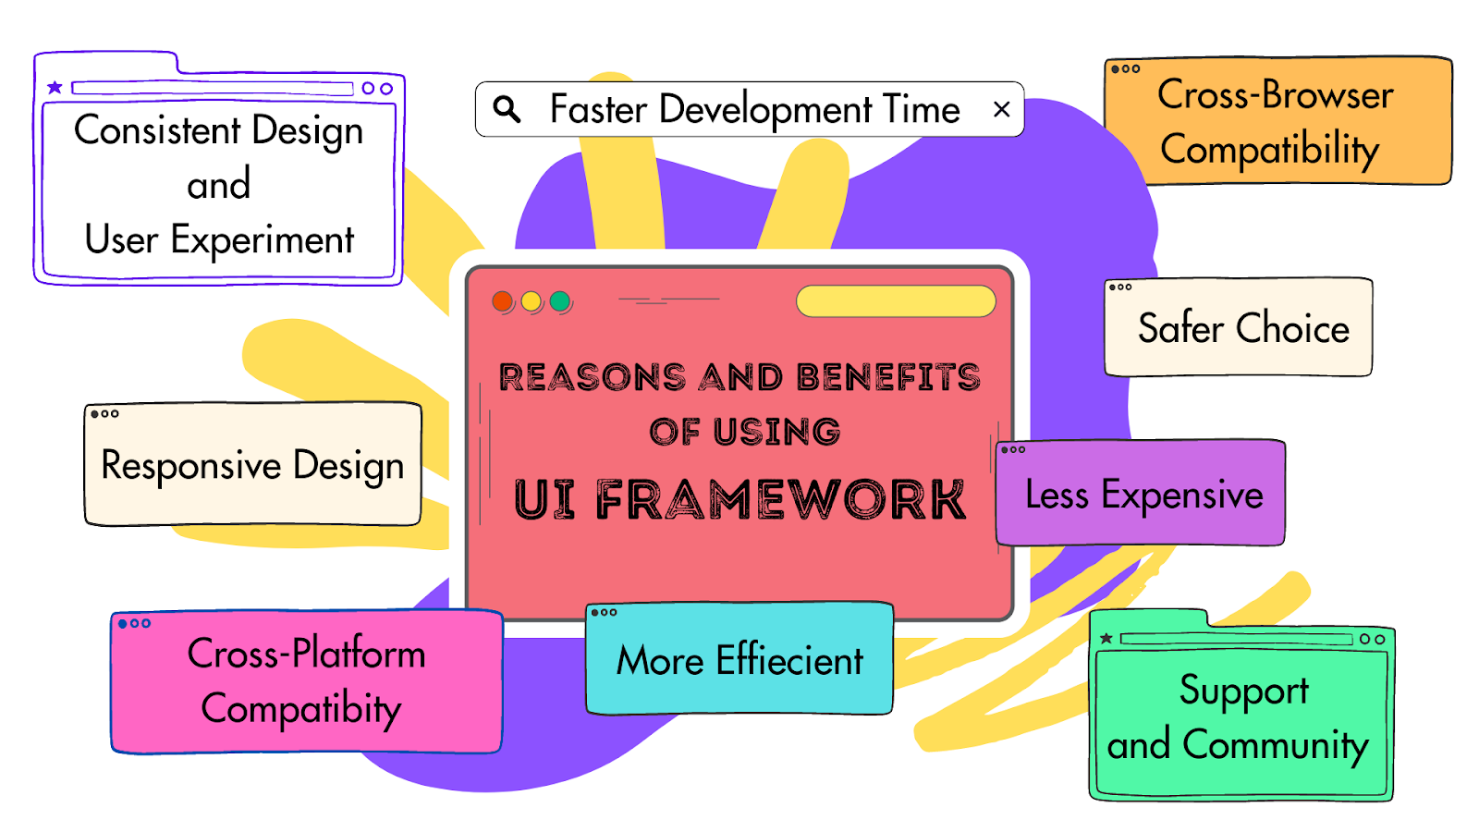
Reasons and Benefits of Using UI Framework

Slide 5
Reasons and Benefits of Using UI Framework
Safer Choice
Faster Development Time
Consistent Design and User Experience
Cross-Platform Compatibility
Less Expensive
Responsive Design
Cross-Browser Friendly
More Efficient

Slide 6
Introduction to ReactJS
ReactJS is an open-source JavaScript library used to build a user interface for Single Page Application(SPA) (Eg.: Facebook, gmail, Twitter)
Multi Page Application(MPA) examples: ecommerce sites like Amazon, FlipKart etc. , Google, GitHub etc.
It is responsible only for the view layer of the application. It provides developers to compose complex UIs from a small and isolated piece of code called components
Note: In SPA page will not be reloaded where as in MPA page will be loaded
each time the user tries to access its contents

Slide 7
Introduction to ReactJS
ReactJS is made up of two parts :
1.Components: the pieces that contain HTML code and what you want to see in the user interface, and
2. HTML document: where all your components will be rendered.

Slide 8
Who Developed ReactJS?
Jordan Walke, who was a software engineer at Facebook, developed it. Initially, it was developed and maintained by Facebook and was later used in its products like WhatsApp & Instagram.
Facebook developed ReactJS in 2011 for the newsfeed section, but it was released to the public in May 2013.

Slide 9
Why we use ReactJS?
ReactJS is to develop User Interfaces (UI) that improves the speed of the apps.
Uses virtual DOM (JavaScript object), which improves the performance of the app.
The JavaScript virtual DOM is faster than the regular DOM.
The virtual DOM works fast as it only changes individual DOM elements instead of reloading complete DOM every time.

Slide 10
DOM (Document Object Model)
DOM
Document
Object
Model
File
Tags/
Elements
Layout structure

Slide 11
DOM
DOM (Document Object Model): It represents the contents of XML or HTML document as tree structure.
It is a technology, with the help of which we can completely control any HTML document with Javascript.
With the help of DOM, we can access and change any tag, id, class or attribute.
We can even change any CSS style with DOM

Slide 12
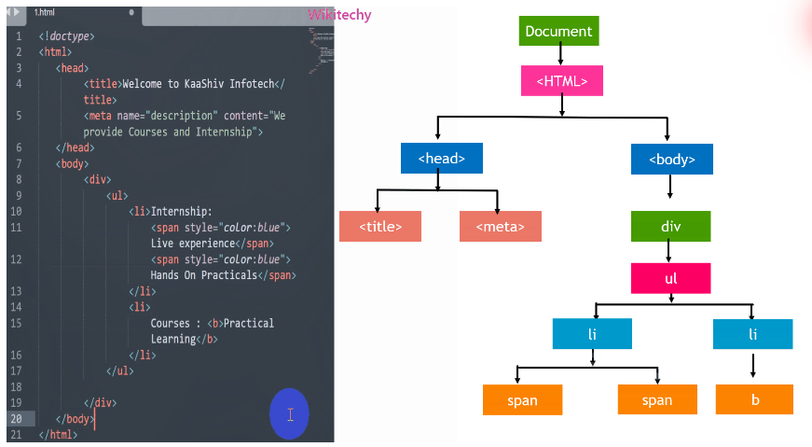
DOM

Slide 13
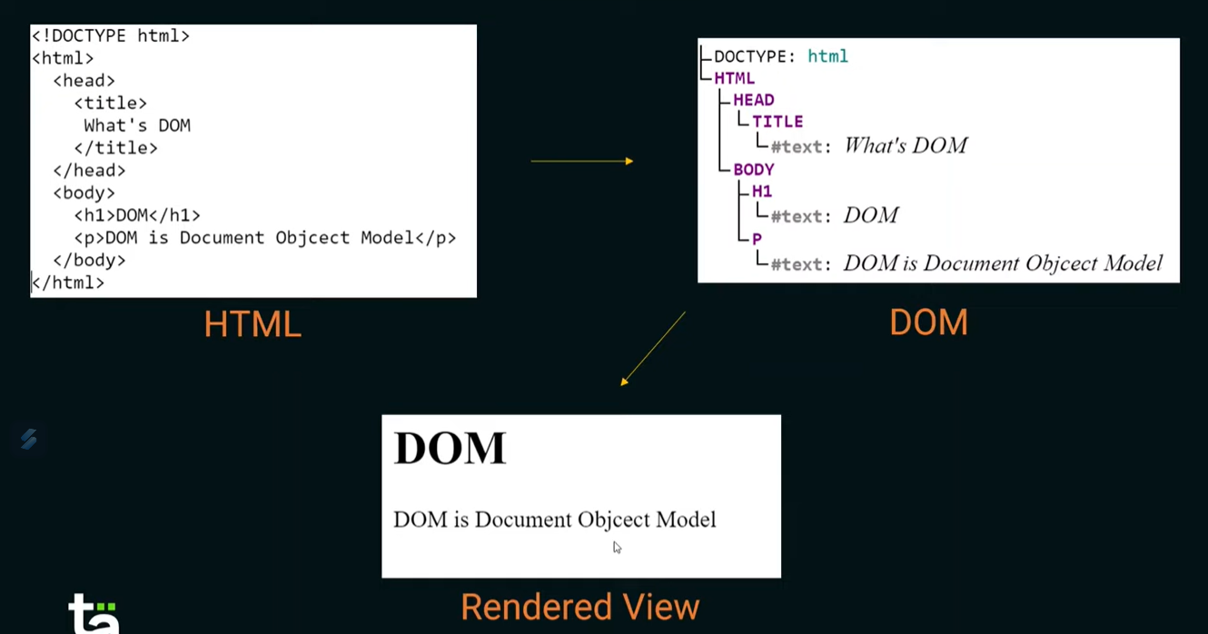

Slide 14
DOM Methods:
getElementById()
getElementsByClassName()
getElementsByTagName()
querySelector()
querySelectorALL() etc..

Slide 15
Features of ReactJS
JSX
Components
One-way Data Binding
Virtual DOM
Simplicity

Slide 16
Features of ReactJS
JSX:
JSX stands for JavaScript XML.
JSX allows us to write HTML in React.
JSX converts HTML tags into react elements.

Slide 17
Features of ReactJS
2. Components:
ReactJS is all about components.
A component is a reusable piece of HTML code.
A ReactJS application is made up of multiple components, each component is responsible for outputting a small, reusable piece of HTML code.
We can reuse the components while building large scale applications.

Slide 18
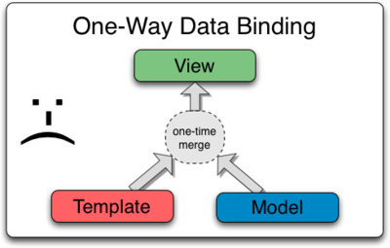
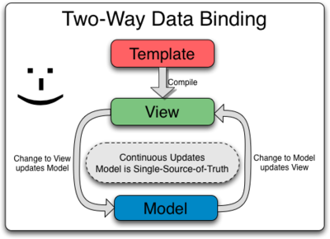
Features of ReactJS
3. One-way Data Binding :
Data binding is the process that establishes a connection between the app UI and the data it displays.
In one-way data binding information flows in only one direction, and is when the information is displayed, but not updated.
In two-way data binding information flows in both directions and is used in situations where the information needs to be updated.

Slide 19
Features of ReactJS
4. Virtual DOM:
A virtual DOM object is a representation of the real DOM object.
Whenever any modifications happen in the web application, the entire UI is re-rendered in virtual DOM representation.

Slide 20
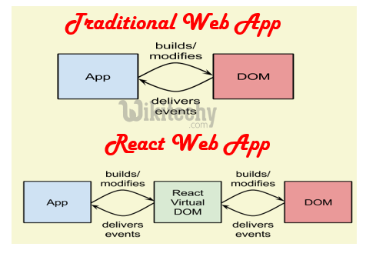
Virtual DOM
Features of ReactJS

Slide 21
Features of ReactJS
5. Simplicity:
ReactJS uses the JSX file, which makes the application simple and to code, as well as understand.
Also, ReactJS is a component-based approach which makes the code reusable as your need.

Slide 22

React Installation
There are two ways to set up an environment for successful ReactJS application. They are given below:
Using the npm command
Using the create-react-app command

Slide 23
React Installation- Using the npm command
Steps:
Install NodeJS and NPM -NodeJS and NPM are the platforms needed to develop any ReactJS application.
Install React and React DOM
Install Webpack -Webpack is used for module packaging, development, and production pipeline automation.
Install Babel- Babel is a JavaScript compiler and transpiler used to convert one source code to others.

Slide 24
React Installation- Using the create-react-app
The npm command method uses many dependencies, configuration files, and other requirements such as Babel, Webpack before writing a single line of React code.
Create React App CLI tool removes all that complexities and makes React app simple.
It does not take any configuration manually. This tool wraps all of the required dependencies like Webpack, Babel for React project itself. This helps the users to focus on writing React code only.

Slide 25
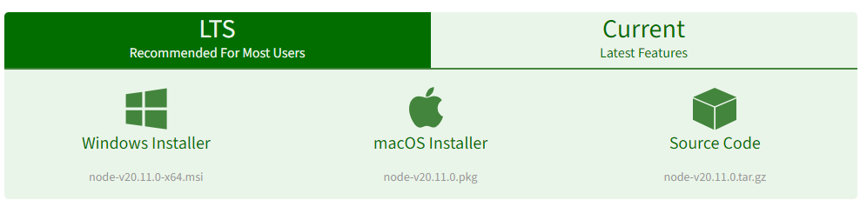
React Installation- Using the create-react-app
Step 1:
Download the Node.js source code or a pre-built installer for your platform using the following link:
Here install the LTS version (the one present on the left). Once downloaded open NodeJS without disturbing other settings, click on the Next button until it’s completely installed.
https://nodejs.org/en/download/
Note: click on windows Installer. The software will be downloaded on your device.

Slide 26
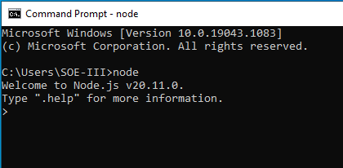
React Installation- Using the create-react-app
Step 2:Open command prompt to check whether it is completely installed or not, type the command –> node
Note: If the installation is done properly, it will give you the version you have installed.

Slide 27
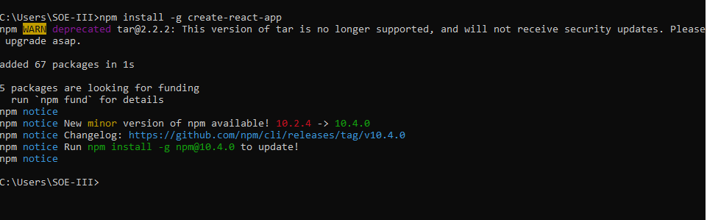

React Installation- Using the create-react-app
Step 3:Now in the terminal run the below command:
npm install -g create-react-app
It will globally install react app for you. To check everything went well run the command create-react-app –version

Slide 28
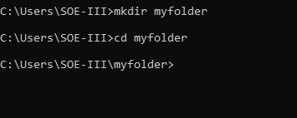
React Installation- Using the create-react-app
Step 4:
Step 4:Now Create a new folder where you want to make your react app using the below command: mkdir myfolder
Note: The myfolder in the above command is the name of the folder and can be any name of your choice.
Move inside the same folder using the command: cd myfolder(your folder name)

Slide 29
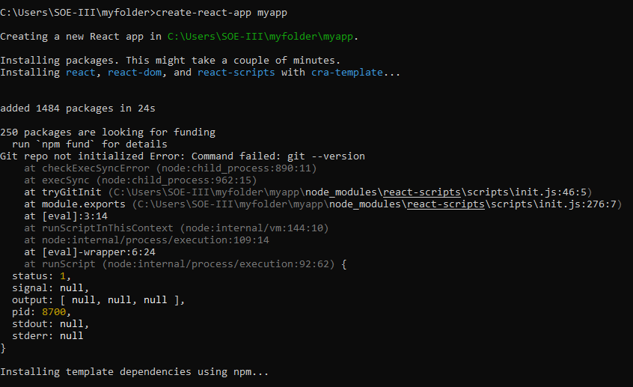
React Installation- Using the create-react-app
Step 5: Now inside this folder run the command :
c:\users\SOE-III\myfolder>create-react-app myapp
myapp:
Name of the app we want to create
NOTE:
It will take some time to install the required dependencies
Due to npm naming restrictions, names can no longer contain capital letters, thus type your app’s name in lowercase.

Slide 30
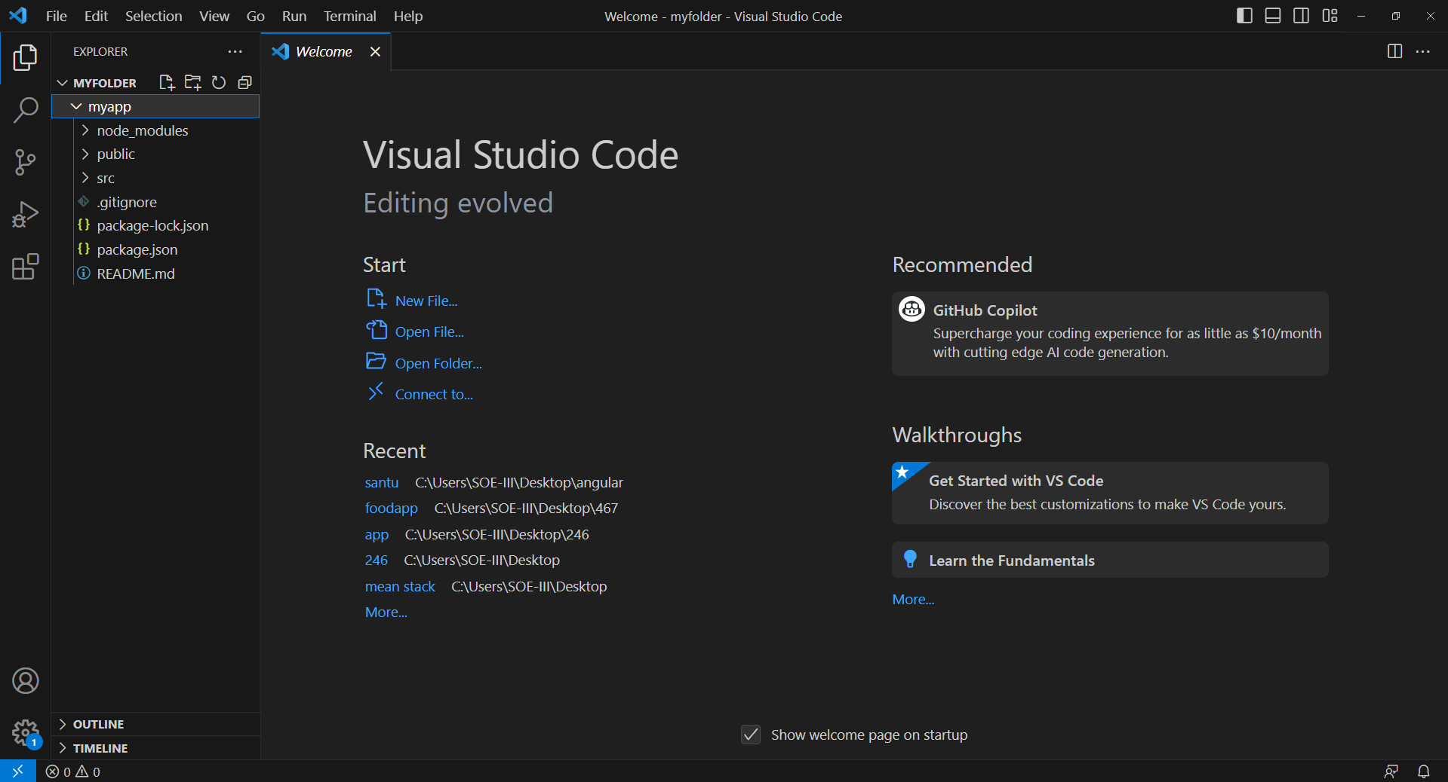
React Installation- Using the create-react-app
Step 6: Now open the IDE of your choice for eg. Visual studio code and then go to
file → open folder→ myfolder .
The following contents will be displayed on the VS code page:

Slide 31
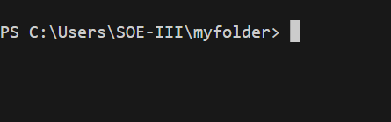
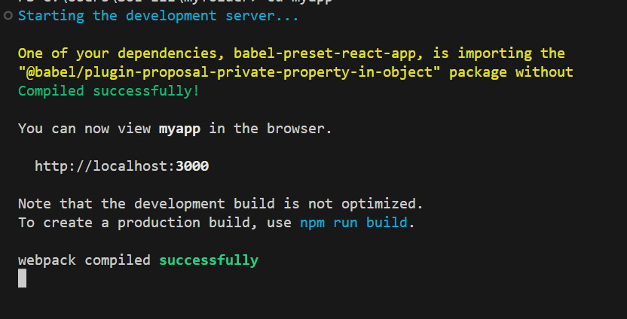
React Installation- Using the create-react-app
Step 7:
Go to Terminal→New Terminal
Now, type c:\Users\SOE-III\myfolder> cd myapp in terminal
To start your app, run the command :
c:\Users\SOE-III\myfolder\myapp> npm start in the terminal window

Slide 32
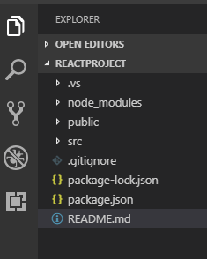
node_modules: It contains the React library and any other third party libraries needed.
public: It holds the public assets of the application. It contains the index.html where React will mount the application by default on the <div id="root"></div> element.
src: It contains the App.css, App.js, App.test.js, index.css, index.js, and serviceWorker.js files. Here, the App.js file always responsible for displaying the output screen in React.
package-lock.json: It is generated automatically for any operations where npm package modifies either the node_modules tree or package.json. It cannot be published. It will be ignored if it finds any other place rather than the top-level package.
README.md: It provides the documentation to read about React topics.

Slide 33
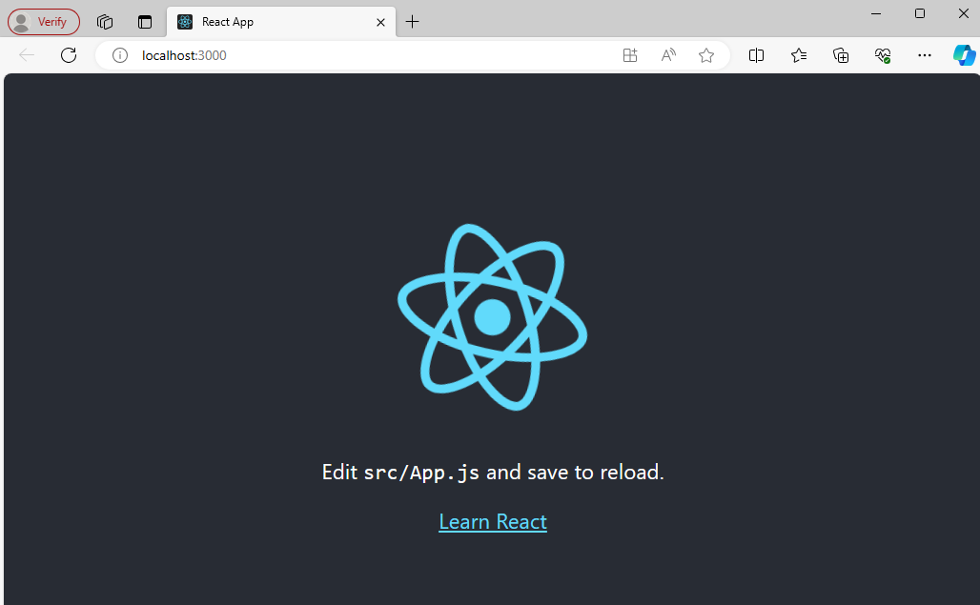
React Installation- Using the create-react-app
Once you run the npm start command a new tab will open in your browser showing React logo as shown below :
Congratulations you have successfully installed the react-app and are ready to build awesome websites and apps

Slide 34
React JSX
JSX stands for JavaScript XML.
JSX allows us to write HTML elements in JavaScript and place them in the DOM without any createElement() and/or appendChild() methods.
JSX converts HTML tags into react elements.
Note: In order to embed a JavaScript expression inside JSX, the JavaScript must be wrapped with curly braces, {}.

Slide 35
Advantages of JSX:
Key Advantages of JSX are:
Visually Expressive: Writing UI elements in JSX closely resembles HTML, making it easier to visualize and understand the structure of your components.
Combines Logic and Markup: JSX enables you to embed JavaScript expressions within the markup, allowing for dynamic content and seamless integration of logic and presentation.
Enhanced Tooling and Error Checking: Compilers and linters can provide better error messages and type checking with JSX, improving code quality and development experience.

Slide 36
Basic Usage of JSX:
Creating Elements:
const element = <h1>Hello, world!</h1>;
Embedding Expressions:
const name = 'John';
const greeting = <h1>Hello, {name}!</h1>;
Nesting Elements:
const listItems = ['Item 1', 'Item 2'];
const list = <ul>{listItems.map(item => <li>{item}</li>)}</ul>;

Slide 37
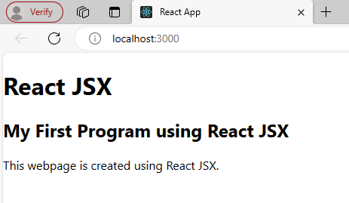
Examples of JSX:
import React, { Component } from 'react';
class App extends Component{
render(){
return(
<div>
<h1>React JSX</h1>
<h2>My First Program using React JSX</h2>
<p>This webpage is created using React JSX.</p>
</div>
);
}
}
export default App;
NOTE:
The render() method in React JavaScript is a technique that updates a user's screen with relevant information when a component state or element properties change

Slide 38
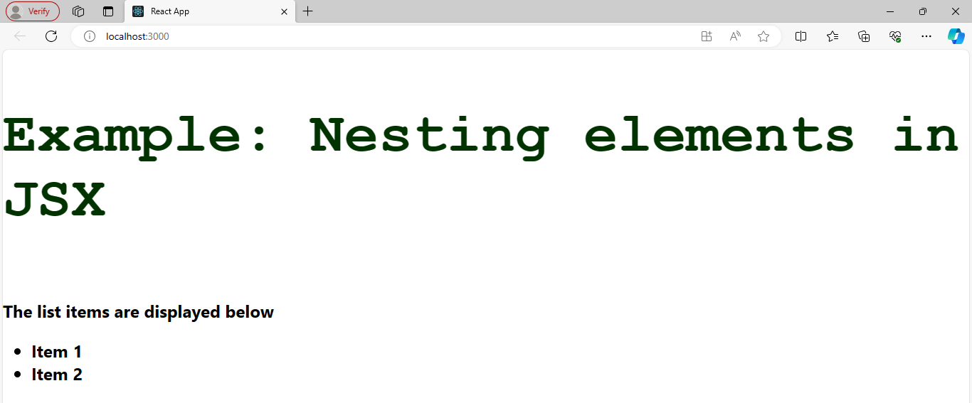
Examples of JSX:
import React, { Component } from 'react';
class App extends Component{
render(){
var myStyle = {
fontSize: 80,
fontFamily: 'Courier',
color: '#003300'
}
const listItems = ['Item 1', 'Item 2'];
const list = <ul>{listItems.map(item => <li>{item}</li>)}</ul>;
return (
<div>
<h1 style={myStyle}>Example: Nesting elements in JSX</h1>
<h2>The list items are displayed below {list}</h2>
</div>
);
}
}
export default App;

Slide 39
JSX-Key Points:
Capitalized Tags: Refer to React components (custom elements you create)
Attributes: Use camelCase instead of HTML attribute names (e.g., className instead of class)
JavaScript Expressions: Enclose them in curly braces ({})
Commenting: Use {/* Comment */} for comments within JSX.
Note: JSX itself isn't HTML. It's transformed into React function calls during the build process.
React offers a way to create UIs without JSX, but most developers prefer its clarity and convenience.

Slide 40
React Components
Components are the fundamental building blocks of React applications.
They act as independent, reusable pieces of UI that encapsulate both the logic and presentation of a particular portion of the interface.
Each component exists in the same space, but they work independently from one another and merge all in a parent component, which will be the final UI of your application.

Slide 41
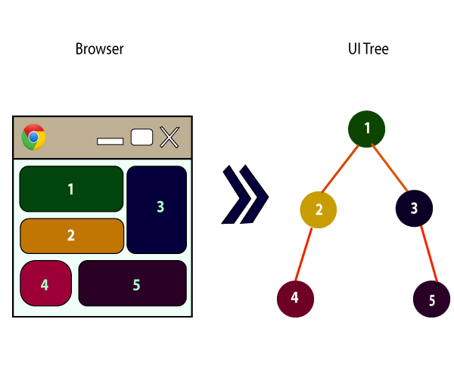

React Components
Every React component have their own structure, methods as well as APIs.
They can be reusable as per your need.
For better understanding, consider the entire UI as a tree.
Here, the root is the starting component, and each of the other pieces becomes branches, which are further divided into sub-branches.

Slide 42
Types of Components:
Functional Components
Class Components

Slide 43
Functional Components
Syntax:
function WelcomeMessage(props) {
return <h1>Welcome to the , {props.name}</h1>;
}
In React, function components are a way to write components.
They are simply JavaScript functions that may or may not receive data as parameters.
We can create a function that takes props(properties) as input and returns what should be rendered. A valid functional component can be shown in the below Syntax.

Slide 44
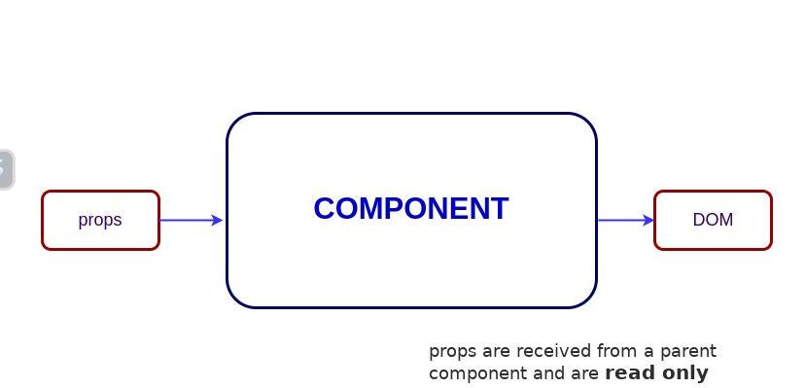
The functional component is also known as a stateless component because they do not hold or manage state.

Slide 45
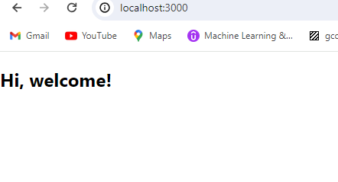
Example
import React, { Component } from 'react';
function welcome() {
return <h2>Hi, welcome!</h2>;
}
export default welcome;
App.js
Output

Slide 46
Class component
A class component must include the extends React.Component statement.
This statement creates an inheritance to React.Component, and gives your component access to React.Component's functions.
The component also requires a render() method, this method returns HTML.
Syntax:
import React, { Component } from 'react'; class MyComponent extends Component {
render() {
return (
<div>This is main component.</div>
);
}
}

Slide 47
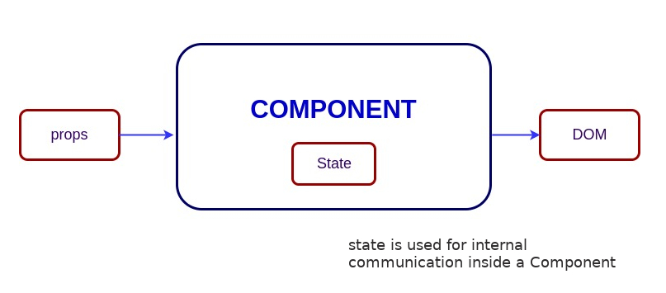
The class component is also known as a stateful component because they can hold or manage local state.

Slide 48
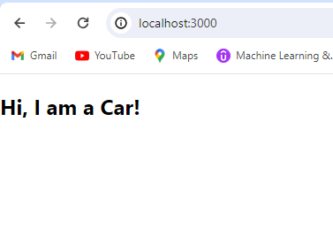
Example
import React, { Component } from 'react';
class Car extends Component {
render() {
return <h2>Hi, I am a Car!</h2>;
}
}
export default Car;
App.js
Output

Slide 49
React State
React components has a built-in state object.
The state object is where you store property values that belong to the component.
Creating the state Object
The state object is initialized in the constructor:

Slide 50
Changing the state Object
To change a value in the state object, use the this.setState() method.
When a value in the state object changes, the component will re-render, meaning that the output will change according to the new value(s)
Example:
Add a button with an onClick event that will change the color property

Slide 51
Changing the state Object
import React, { Component } from 'react';
class Car extends Component {
constructor() {
super();
this.state = {
brand: "Ford",
model: "Mustang",
color: "red",
year: 1964 };
}
changeColor = () => { this.setState({color: "blue"})};
render() {
return (
<div>
<h1>My {this.state.brand}</h1>
<p> It is a {this.state.color} {this.state.model} from {this.state.year}. </p>
<button type="button" onClick={this.changeColor} >Change</button>
</div> ); } }
export default Car

Slide 52
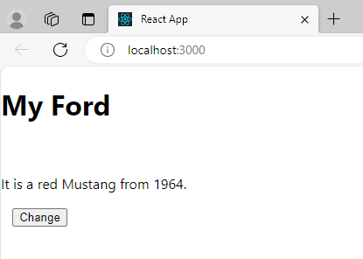
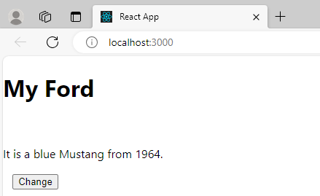
Changing the state Object- Example- OUTPUT
Before Pressing the Button:
After Pressing the Button:

Slide 53
React Props
Props stand for "Properties." They are read-only components
It is an object which stores the value of attributes of a tag and work similar to the HTML attributes.
It gives a way to pass data from one component to other components.
Props are passed to the component in the same way as arguments passed in a function.
Props are immutable so we cannot modify the props from inside the component.
Inside the components, we can add attributes called props.
These attributes are available in the component as this.props and can be used to render dynamic data in our render method.

Slide 54
Example: PROPS
import React, { Component } from 'react';
class App extends React.Component {
render() {
return (
<div>
<h1> Welcome to { this.props.name } </h1>
<p> React is a JavaScript library for building user interfaces.</p>
<p>React is used to build single-page applications.</p>
<p>React allows us to create reusable UI components. </p>
</div>
);
} }
export default App;
App.js

Slide 55
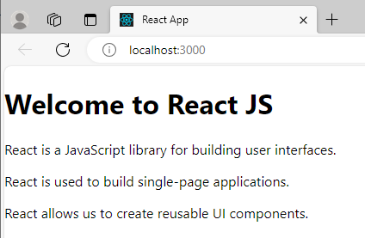
Example: PROPS
import React from 'react';
import ReactDOM from 'react-dom/client';
import './index.css';
import App from './App';
import reportWebVitals from './reportWebVitals';
const root = ReactDOM.createRoot(document.getElementById('root'));
root.render(
<React.StrictMode>
<App name="React JS" />
</React.StrictMode>
);
reportWebVitals();
index.js

Slide 56
Default Props
It is not necessary to always add props in the reactDom.render() element. You can also set default props directly in the component constructor. It can be explained in the next example.

Slide 57
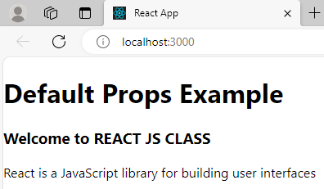
Default props- Example
import React, { Component } from 'react';
class App extends React.Component {
render() {
return (
<div>
<h1>Default Props Example</h1>
<h3>Welcome to {this.props.name}</h3>
<p>React is a JavaScript library for building user interfaces</p>
</div>
);
}
}
App.defaultProps = {
name: "REACT JS CLASS"
}
export default App;
App.js
NOTE:
No changes in the index.js file

Slide 58
Comparison between State and Props
S.No. | Props | State
1. | Props are read-only. | State changes can be asynchronous.
2. | Props are immutable. | State is mutable.
3. | Props allow you to pass data from one component to other components as an argument. | State holds information about the components.
4. | Props can be accessed by the child component. | State cannot be accessed by child components.
5. | Props are used to communicate between components. | States can be used for rendering dynamic changes with the component.
6. | Stateless component can have Props. | Stateless components cannot have State.
7. | Props make components reusable. | State cannot make components reusable.
8. | Props are external and controlled by whatever renders the component. | The State is internal and controlled by the React Component itself.

Slide 59
Adding Images in React- Using Functional Component
import React, { Component } from 'react';
import img3 from './img3.jpg'
function Header() {
// Import result is the URL of your image
return (
<div>
<h1>Displaying Image</h1>
<img src={img3} alt="image" width="50%" height="50%" />
<h1> This Program displays Mountains</h1>
</div>
);
}
export default Header;
Adding image in src folder:
Drag and drop the image in the src folder
In this example, the image is : img3.jpg

Slide 60
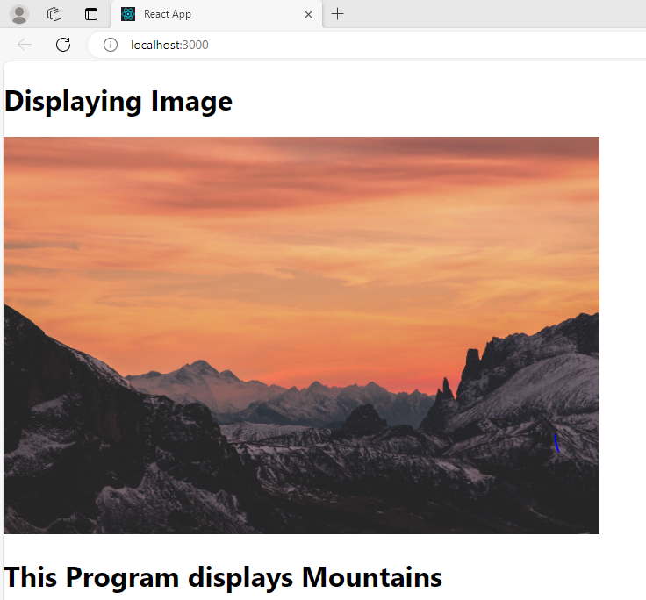
OUTPUT

Slide 61
Adding Images in React- Using Class Component
import React, { Component } from 'react';
import img3 from './img3.jpg'
class App extends Component
{
render()
{
return (
<div>
<h1>Displaying Image</h1>
<img src={img3} alt="image" width="50%" height="50%" />
<h1> This Program displays Mountains</h1>
</div>
);
}
}
export default App;
Adding image in src folder:
Add image file to the src folder
Here, the image is added as img3.jpg

Slide 62
OUTPUT

Slide 63
React Component Life Cycle
In ReactJS, every component creation process involves various lifecycle methods. These lifecycle methods are termed as component's lifecycle.
These lifecycle methods are not very complicated and called at various points during a component's life.
The lifecycle of the component is divided into four phases. They are:
Initial Phase
Mounting Phase
Updating Phase
Unmounting Phase

Slide 64
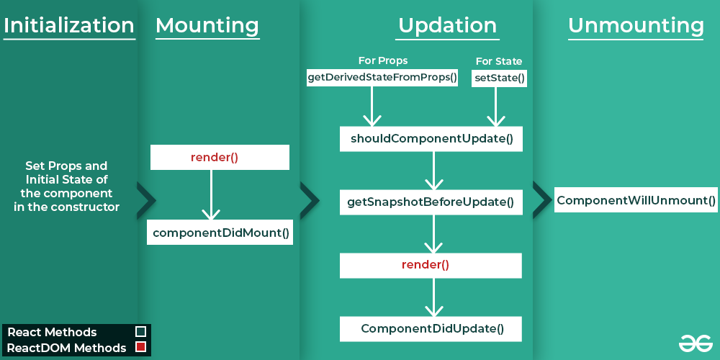
Life Cycle Components Diagram

Slide 65
Initial Phase
It is the birth phase of the lifecycle of a ReactJS component. Here, the component starts its journey on a way to the DOM.
Component contains the default Props and initial State.
These default properties are done in the constructor of a component.
The initial phase only occurs once and consists of the following methods.
getDefaultProps()
getInitialState()

Slide 66
Mounting
Mounting means putting elements into the DOM.
React has four built-in methods that gets called, in this order, when mounting a component:
componentWillMount()
componentDidMount()
render()
The render() method is required and will always be called, the others are optional and will be called if you define them.

Slide 67
Updating
A component is updated whenever there is a change in the component's state or props.
This phase consists of the following methods.
componentWillRecieveProps()
shouldComponentUpdate()
componentWillUpdate()
render()
componentDidUpdate()

Slide 68
Unmounting
The next phase in the lifecycle is when a component is removed from the DOM, or unmounting as React likes to call it.
React has only one built-in method that gets called when a component is unmounted:
componentWillUnmount()

Slide 69
React Forms
Just like in HTML, React uses forms to allow users to interact with the web page.
A form can contain text fields, buttons, checkbox, radio button, etc.
In HTML, form data is usually handled by the DOM.
In React, form data is usually handled by the components.
In React, the form is usually implemented by using controlled components.
There are mainly two types of form input in React.
Uncontrolled component
Controlled component

Slide 70
Uncontrolled component:
In the Uncontrolled Form component, the state of the input is not controlled by the React component.
This means that when the user changes the value of the input, the state is not updated and the component is not re-rendered.
The uncontrolled input is similar to the traditional HTML form inputs.
The DOM itself handles the form data.
Here, the HTML elements maintain their own state that will be updated when the input value changes.

Slide 71
Controlled Component
In the ControlledForm component, the state of the input is controlled by the React component.
This means that when the user changes the value of the input, the state is updated and the component is re-rendered.
In the controlled component, the input form element is handled by the component rather than the DOM.

Slide 72
Here, the mutable state is kept in the state property and will be updated only with setState() method.
Controlled components have functions that govern the data passing into them on every onChange event, rather than grabbing the data only once.

Slide 73
Differences Between Controlled and Un Controlled Forms
SN | Controlled | Uncontrolled
1. | It does not maintain its internal state. | It maintains its internal states.
2. | Here, data is controlled by the parent component. | Here, data is controlled by the DOM itself.
3. | It accepts its current value as a prop. | It uses a ref for their current values.
4. | It allows validation control. | It does not allow validation control.
5. | It has better control over the form elements and data. | It has limited control over the form elements and data.

Slide 74
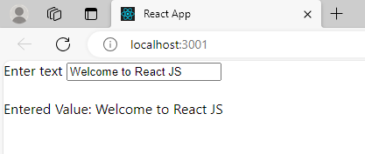
Creating a Form - Example
import React from 'react';
class App extends React.Component {
state = { inputValue: '' };
render() {
return (
<div>
<form>
<label> Enter text </label>
<input type="text"
value={this.state.inputValue}
onChange={(e) => this.setState(
{ inputValue: e.target.value })} />
</form> <br />
<div>
Entered Value: {this.state.inputValue}
</div>
</div>
);}
}export default App;

Slide 75
THANK YOU

